Slide 1

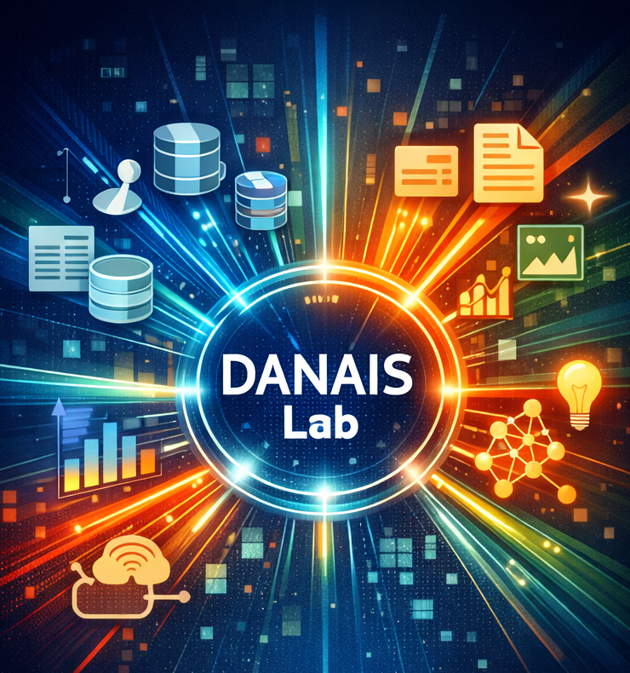
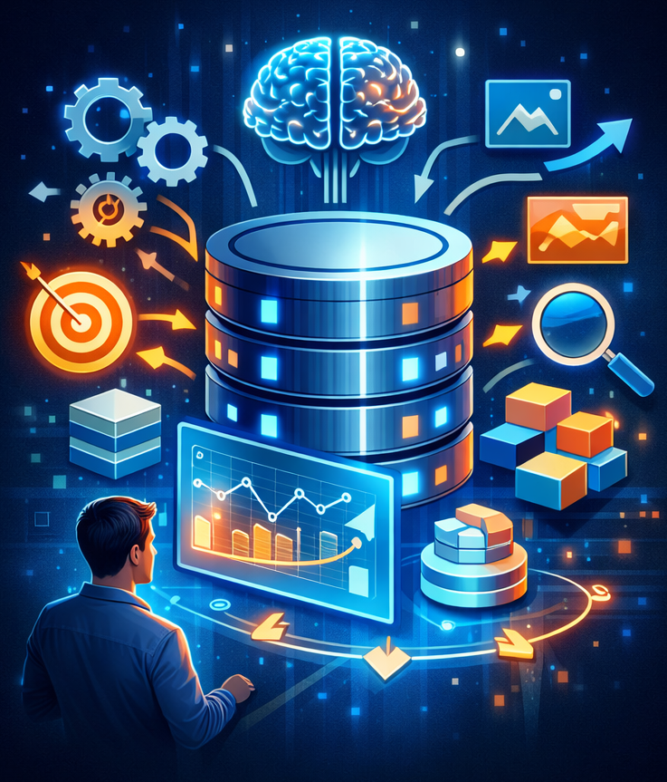

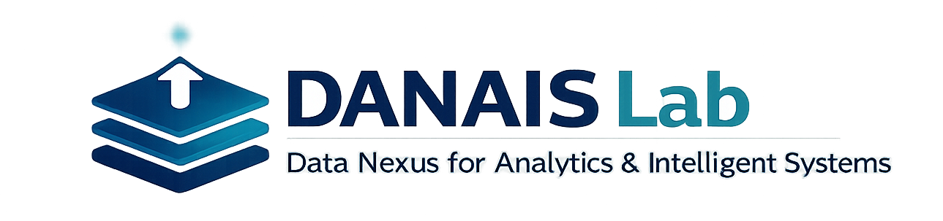
A/Prof Renata Borovica-Gajic
Data Nexus for Analytics & Intelligent Systems
DANAIS Lab (https://danais-lab.com/)
About us
The DANAIS (Data Nexus for Analytics & Intelligent Systems) Lab conducts foundational and applied research at the intersection of data management, analytics, and intelligent systems.
Our work focuses on designing scalable data architectures, robust database systems, and integrated analytic frameworks that transform complex, heterogeneous data into reliable, actionable insight. By uniting advances in data storage, integration, analytics, and systems engineering, DANAIS develops the foundations required for data-driven intelligence across domains.
The lab’s research spans database and data systems design, analytics and machine learning, and intelligent systems that operationalize insight at scale. DANAIS aims to bridge theory and practice, enabling principled, efficient, and trustworthy data-driven decision making.
DANAIS: A data nexus where analytics, systems, and intelligence converge
Research Vision
Modern analytics and AI applications rely critically on the capabilities of the underlying data systems. Traditional database architectures are increasingly challenged by dynamic workloads, noisy data, and the growing complexity of analytic pipelines.
The DANAIS Lab addresses these challenges by developing a data nexus: integrated data systems that combine adaptive database techniques, learning-based optimization, and analytics-driven system design.
The lab’s vision is to enable efficient, self-optimizing, and insight-driven data systems that support exploratory analytics, intelligent decision making, and real-world data-driven applications.
Showcasing AI-powered database project (https://ai-db-uom.github.io/)
AI-powered databases aim to facilitate data exploration and insight discovery in large and intricate databases commonly found in data-rich industries and scientific fields. These insights can improve business processes, reduce production costs, and lead to new discoveries in scientific disciplines. Despite their benefits, data exploration often proves arduous and time-consuming, demanding substantial expertise to prepare databases for analysis. This project pioneers a new generation of AI-powered self-driving databases, leveraging Machine Learning and Artificial Intelligence to automate the complex and labor-intensive tasks associated with database preparation, typically carried out by expensive specialists.
Automated Database Tuning: Optimizes database performance automatically, removing the need for costly expert intervention. [ICDE’21, ICDM’21, VLDB’22, TKDE’23, ICDM’24, SIGMOD’26]
(Machine) Learned Indexes: Leverages data patterns to create compact ML-based indexes for faster and more efficient data retrieval. [SIGMOD’23, ICDE’24, VLDB’25, ICDE’26]
Semantics-Driven Prefetching: Anticipates and preloads relevant data to reduce query latency and improve exploration efficiency. [VLDB’24]
Cardinality Estimation: Predicts query result sizes to enhance query planning and execution performance. [ICDE’26]
Predicting Next Action in Data Exploration: Predict and suggest the most relevant next steps during interactive data exploration, helping guide users through complex analysis workflows. [CIKM’25]
Meet the team

